Slide 1
Perbandingan
MLP dan LVQ
Repository:
https://github.com/vincentmichael089/ML-ANN/tree/master/2.MLP-LVQ%20Comparison

Slide 2
1
Terdiri dari 50 data
2
Memiliki 5 fitur
Dataset:
Video-Store
Gender, Income, Age, Rentals, Average Visit, dan Incidentals
3
Memiliki 3 kelas target
Target Action, Drama, dan Comedy
Repository:
https://github.com/vincentmichael089/ML-ANN/tree/master/2.MLP-LVQ%20Comparison

Slide 3
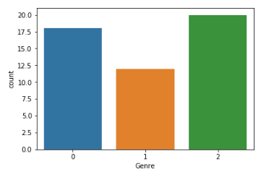
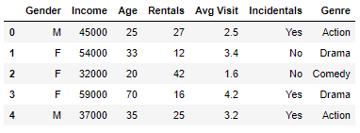
DATASET: VIDEO-STORE
Repository:
https://github.com/vincentmichael089/ML-ANN/tree/master/2.MLP-LVQ%20Comparison

Slide 4
Multi Layer
Perceptron
Repository:
https://github.com/vincentmichael089/ML-ANN/tree/master/2.MLP-LVQ%20Comparison

Slide 5
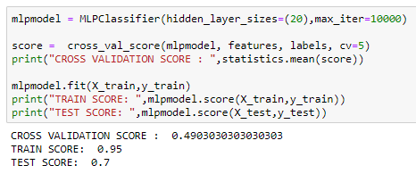
MULTI LAYER PERCEPTRON : SCORE
Repository:
https://github.com/vincentmichael089/ML-ANN/tree/master/2.MLP-LVQ%20Comparison

Slide 6
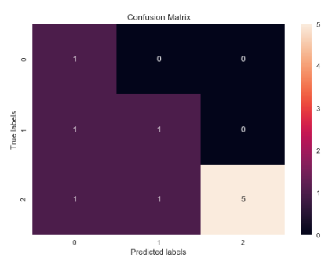
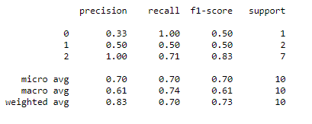
MULTI LAYER PERCEPTRON : CLASSIFICATION REPORT
Repository:
https://github.com/vincentmichael089/ML-ANN/tree/master/2.MLP-LVQ%20Comparison

Slide 7
Learning Vector
Quantization
Repository:
https://github.com/vincentmichael089/ML-ANN/tree/master/2.MLP-LVQ%20Comparison

Slide 8
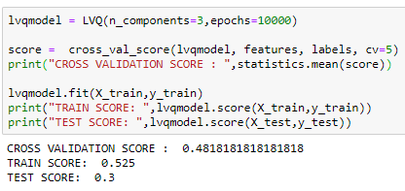
LEARNING VECTOR QUANTIZATION : SCORE
Repository:
https://github.com/vincentmichael089/ML-ANN/tree/master/2.MLP-LVQ%20Comparison

Slide 9
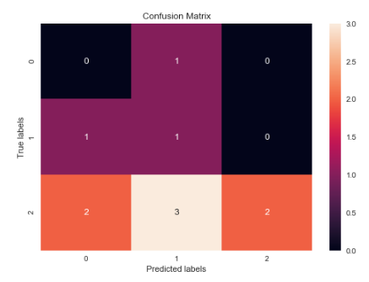
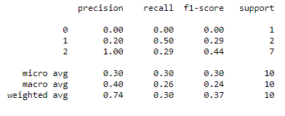
LEARNING VECTOR QUANTIZATION : CLASSIFICATION REPORT
Repository:
https://github.com/vincentmichael089/ML-ANN/tree/master/2.MLP-LVQ%20Comparison

Slide 10
1
Pada dataset Video-Store arsitektur
MLP menghasilkan performa yang lebih
baik daripada LVQ
MLP Train: 0.95 Test : 0.7
LVQ Train: 0.525 Test : 0.3
Kesimpulan
2
5-Fold Cross Validation pada kedua model
menghasilkan hasil yang tidak jauh berbeda
MLP : 0.4903030303030303
LVQ : 0.4818181818181818
Repository:
https://github.com/vincentmichael089/ML-ANN/tree/master/2.MLP-LVQ%20Comparison

Slide 11
TERIMA KASIH
Repository:
https://github.com/vincentmichael089/ML-ANN/tree/master/2.MLP-LVQ%20Comparison

